Slide 1
Possible Causes of Asperger's and Autism
Mimi McCarthy, Tara McKinnon, Andrew Bennett, Christen Williams and Maddie Daniel

Slide 2
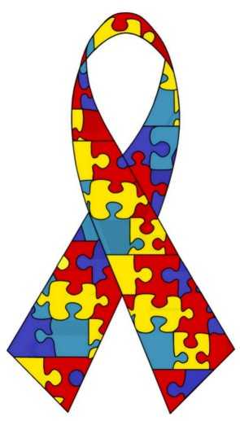
Disclaimer
Autism and Asperger’s are poorly understood, which is why their treatment and prevention are difficult
The following information highlights factors that are correlated with higher instances of Autism and Asperger’s

Slide 3
Correlation Factors
Genetics
Pharmaceuticals
Parental age
Gender

Slide 4
Genetics
Highly heritable
Though not proven, there are 20 genes that may lead to Autism.
Most of these genes deal with brain development and growth, along with communication between brain cells.
Single child families with autism have a 1 in 20 chance of their second child being autistic as well.

Slide 5
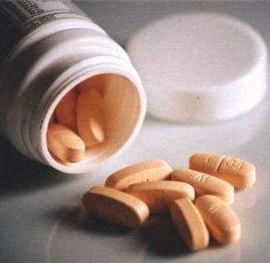
Pharmaceuticals
Lots of debate in the past few years over vaccination and drug use as increasing risk of autism
The use of some drugs seems to be correlated to higher autism rates, but others are little more than myths

Slide 6
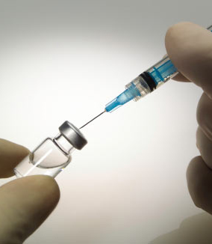
Vaccine Myth
Originated in the late 1990s when a British surgeon hypothesized that a measles-mumps-rubella (MMR) shot caused children to develop autism
12 studies showed no difference in chances of developing autism between children who did and didn’t receive the vaccine
Later, a similar claim was made about thimerosal, but again, studies showed no difference between those receiving or not receiving the vaccines

Slide 7
Drugs
Studies have shown women who take certain types of anti-depressants such as Zoloft or Prozac are twice as likely to have children with autism or a similar disorder.
This class of anti-depressants is called a selective serotonin inhibitor (SSRI), which can potentially become a more dangerous risk for a child in it’s first trimester.
A child exposed to such drugs has a nearly four times more likely chance to be diagnosed with Austism.

Slide 8
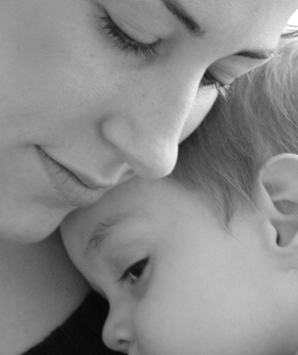
Parental Age
When either parent is over the age of 35, the risk of having an autistic child increases
Older fathers increase risk more than older mothers because
The older they get, the more genetic mutations they pass on to offspring- father’s age accounts for almost all of the mutations in a child’s genome
A 70-year-old man will pass on approximately four times as many mutations to his child as a 36-year-old man
The more mutations received, the more likely one of them will cause autism
Eggs are more genetically stable than sperm to begin with, so mutations are less of an issue in women

Slide 9
Gender
Not a direct cause of autism
Much higher frequency in males than females
Possible reasons for frequency imbalance:
Different hormone levels in the uterus
Young girls tend to start out with better social skills than boys; a more severe case would be necessary to put them on the autism spectrum.

Slide 10
Possible Causes of Asperger’s
There currently is no single known cause of Asperger's, however most doctors theorize that it is entirely hereditary.
No specific gene for Asperger’s has been found, however but doctors have noticed the way is passes in families and usually, in twins, if one twin has Asperger’s, then usually the other does.

Slide 11
Possible Causes of Asperger’s (continued)
Each individual case of Asperger’s is different, which makes it difficult to determine a exact cause, however doctors examine family members who show Asperger’s symptoms which can be mild or limited.

Slide 12
Sources
"Asperger Syndrome Fact Sheet." : National Institute of Neurological Disorders and Stroke (NINDS). National Institutes of Health, n.d. Web. 30 Sept. 2012.
Callaway, Ewen. "Fathers Bequeath More Mutations as They Age." Nature.com. Nature Publishing Group, 22 Aug. 2012. Web. 28 Sept. 2012.
Carey, Benedict. "Study Finds Risk Of Autism Linked To Older Fathers." The New York Times. The New York Times, 23 Aug. 2012. Web. 28 Sept. 2012.
"Concern About Autism." Centers for Disease Control and Prevention. Centers for Disease Control and Prevention, 26 June 2012. Web. 28 Sept. 2012.
Offit, Paul. "Vaccines Cause Autism." Vaccines and Autism by Paul Offit. Newsweek, n.d. Web. 30 Sept. 2012.
Szatmari., Peter. "How Girls and Boys Differ When It Comes to Autism - CNN.com."CNN. Cable News Network, 01 Jan. 1970. Web. 28 Sept. 2012.
Wright, Jessica. "Genetics: Maternal and Paternal Age Increase Risk of Autism." Simons Foundation Autism Research Initiative. 6 Mar. 2012. Web. 28 Sept. 2012.
Boyles, Salynn. "Antidepressant Use in Pregnancy: Autism Risk?" WebMD. WebMD, 04 July 2011. Web. 02 Oct. 2012. <http://www.webmd.com/brain/autism/news/20110701/antidepressant-use-in-pregnancy-autism-risk>.
Centers for Disease Control and Prevention. Centers for Disease Control and Prevention, 19 June 2012. Web. 02 Oct. 2012. <http://www.cdc.gov/ncbddd/autism/research.html>.
Harding, Anne, and Copyright Health Magazine 2011. "Antidepressant Use in Pregnancy May Raise Autism Risk." CNN. Cable News Network, 06 July 2011. Web. 02 Oct. 2012. <http://www.cnn.com/2011/HEALTH/07/04/antidepressant.pregnancy.autism.risk/index.html>.

