Slide 1
Famous People & Autism
Brooke
Cassidy
Mary Kate
Mary Margaret
Jennah

Slide 2
Works Cited
Candido, Angeline. "How James Durbin Overcame Tourette's and
Asperger'sto Steal the Show on American Idol." Wer Paint. n. page. Web. 2 Oct. 2012.
Cirelli, Cheryl. "Famous People Suspected to Have Autism." Love
to Know Autism. N.p., 2012. Web. 2 Oct 2012.
"Famous People With Autism." Autism Epicenter. N.p., August
2012. Web. 2 Oct 2012.
"Stephen Wiltshire MBE - Biography." Stephen Wiltshire. N.p.,
January 2012. Web. 2 Oct 2012.

Slide 3
James Durbin
James Durbin has Tourette’s and Aspergerssyndrome
Asperger’s is in the spectrum of autism
Those usually have below average abilities with social interaction, attention and speech

Slide 4
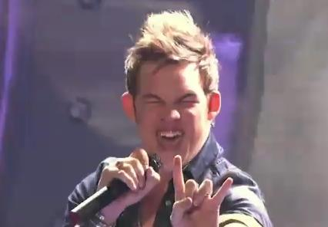
James Durbin

Slide 5
James Durbin
After his father died of a drug overdose, he learned he had tourettes and Aspergers
He is talented in singing
Auditioned for American Idol in season 8 but didn’t make it to Hollywood
On season 10 of the show, he was eliminated in the top 4

Slide 6
James Durbin
After being eliminated from American Idol, he was on The Tonight Show with Jay Leno, Live with Regis and Kelly, Today, Late Night with Jimmy Fallon, and The Ellen DeGeneres Show.
He also appeared in the documentary Different Is the New Normal
This film is about a teen that is trying to over come tourettes

Slide 7
James Durbin
Durbin said: “I have Tourettes and Aspergers, but Tourrets and Aspergers don't have me. You know, I'm doing what I can to suppress it and I don't let it take advantage of me. It's not who I am. You know, I'm James Durbin. Like I said in the beginning, I am here to show America who I am, and it is what it is.”

Slide 8
BirgerSellin
born February 1st 1973 in Berlin, Germany, and wasdiagnosed with an unspecified form of autism

Slide 9
BirgerSellin
He became the first functionally non-verbal published author
His first book, I Don’t Want to Be Inside Me Anymore: Messages From an Autistic Mind, was published in 1993

Slide 10
BirgerSellin
He practiced facilitated communication, which is a form oftyped communication for people with impaired speech
In facilitatedcommunication there is a helper who guides and helps the communicator type what they are trying to say
Eventually most of these people are able to learn to type on their own, without guidance

Slide 11
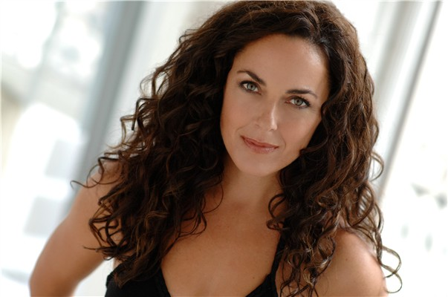
Michelle Dawson
Michelle Dawson was born in 1961 and diagnosed with high-functioningautism

Slide 12
Michelle Dawson
She later became an autism rights-activist and challenged manyof the views held towards people with autism
She believes that ratherthan focusing on the limitations of autism, researchers and therapistsshould focus on the things they are able to do exceptionally well. From there more progress will be able to be made in helping them succeed

Slide 13
Michelle Dawson
Her work has generated a lot of controversy
She has been able to work with doctors to produce various research papers on the topic

Slide 14
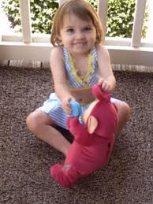
Karen and Paul McCarron
The McCarron’s daughter Katie, was diagnosed with autism in 2004

Slide 15
Katie McCarron
In September of the same year Paul and Katie decided to move from their hometown in Illinois to Cary, North Carolina so that Katie could attend a special school for autistic kids called Mariposa School
About a year or two after living in North Carolina, Paul and Katie returned to Illinois

Slide 16
Katie McCarron
Katie’s father had to commute back to Cary to complete his last three weeks of work, and during that time Karen was reported to having suffocating Katie to death and then overdosing on non-prescription medication.

Slide 17
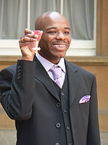
Stephen Wiltshire
Stephen Wiltshire was born on 24th April, 1974 in London

Slide 18
Stephen Wiltshire
Wiltshire was diagnosed with autism at a young age
It was first noticed when he was unable to talk at age 3
When he was five, he was sent to Queensmill School in London

Slide 19
Stephen Wiltshire
There it was discovered that his only interest was drawing
He was mainly interested in drawing cars and animals
He began drawing detailed pictures of made up city buildings similar to the London buildings

Slide 20
Stephen Wiltshire
A teacher realized his interest in drawing and decided to use that as an advantage to encourage speech
The teacher took away his art supplies and forced a response from Stephen
His first word was “paper” and was able to fully speak by age 9

Slide 21
Famous People Suspected of Having Autism

Slide 22
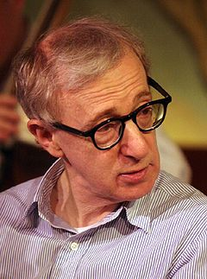
Woody Allen
Born December 1, 1935
He is a three-time Academy Award-winning American film director, writer, actor, jazz musician, comedian and playwright.

Slide 23
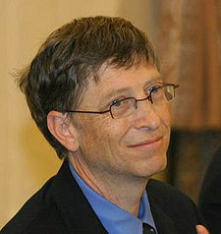
William Henry Gates III
Born October 28, 1955
Chairman of Microsoft

Slide 24
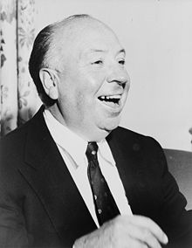
Sir Alfred Joseph Hitchcock
Born August 13, 1899
Died April 29, 1980
Directed more than 50 feature films

Slide 25
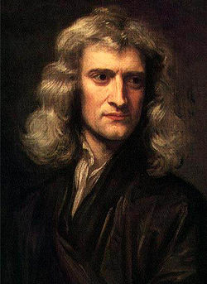
Sir Isaac Newton
Born January 4, 1643
Died March 31 , 1727
Was an English physicist, mathematician, astronomer, theologian, natural philosopher, and alchemist

Slide 26
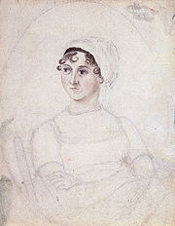
Jane Austen
Born December 16, 1775
Died July 18, 1817
A British novelist

Slide 27
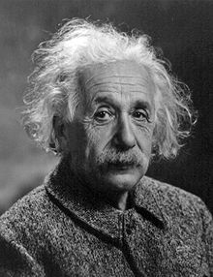
Albert Einstein
Born March 14, 1879
Died April 18, 1955
Was a German-born theoretical physicist. He is best known for his theory of relativity and specifically mass-energy equivalence, E = mc².

Slide 28
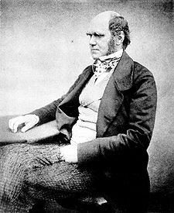
Charles Robert Darwin
Born February 12, 1809
Died April 19, 1882
Was an English naturalist

Slide 29
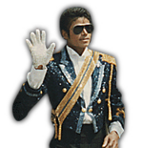
Michael Jackson
Born August 29, 1958
Died June 25, 2009
He was an American musician and is known as the king of pop

Slide 30
"AutismParents.NET!" Â» Famous People with Autism. N.p., n.d. Web. 28 Sept. 2012. <http://autismparents.net/famous-people-with-autism/famous-people-with-autism-katherine-katie-mccarron-beautiful-precious-and-happy-child-with-autsim-spectrum-disorder-killed-by-mom/>.

