Slide 1
Honors English I
September 19th through 23rd

Slide 2
Monday, September 19th
Short Story Unit Test

Slide 3
Tuesday, September 20th
Journal
DLP
Vocabulary Quiz
New vocabulary words
Get grammar workbooks; do grammar pretest
Introduce outside reading: The Hobbit

Slide 4
Journal 7
What was your favorite short story that we read? Why? What was your least favorite? Why? What is your favorite short story that you have ever read? Please describe it and tell me why it is your favorite.

Slide 5
Proofreading Warm-up
Item 1
Roger was caught when he tries to steal a purse
Corrected
Roger was caught when he tried to steal a purse.

Slide 6
Proofreading Warm-up
Item 2
Mrs jones might of asked him to set down and explain his actions but she feed him dinner instead.
Corrected
Mrs. Jones might have asked him to sit down and explain his actions, but she fed him dinner instead.

Slide 7

Adversity
Hardship; great misfortune

Slide 8
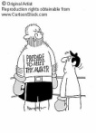
Formidable
awe-inspiring by reason of excellence; strikingly impressive.

Slide 9
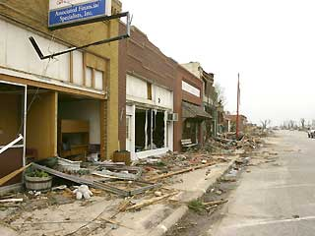
Ravage
v.: destroy violently; ruin.

Slide 10
Profusion
n.: large supply; abundance.

Slide 11
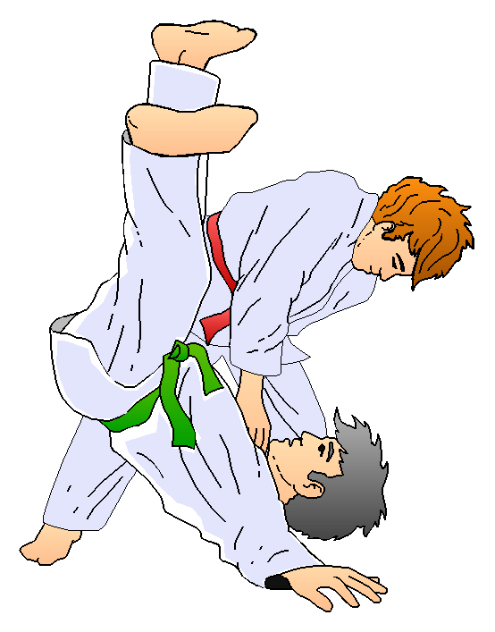
Adversary
n.: enemy; opponent.

Slide 12
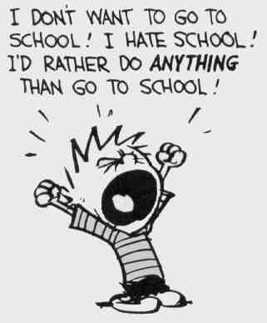
Rancor
n.: bitter hatred; ill will.

Slide 13
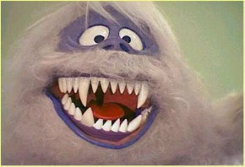
Abominably
adv.: in an extremely unpleasant or disgusting manner.

Slide 14
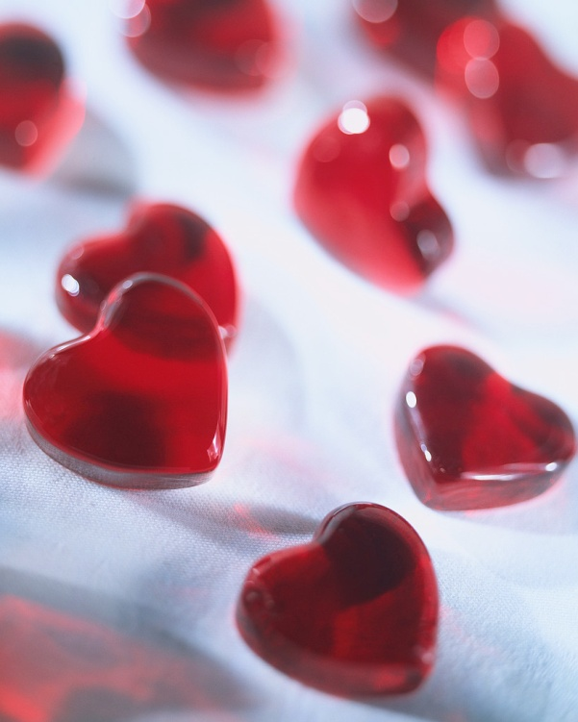
Ardor
n.: passion; enthusiasm.

Slide 15
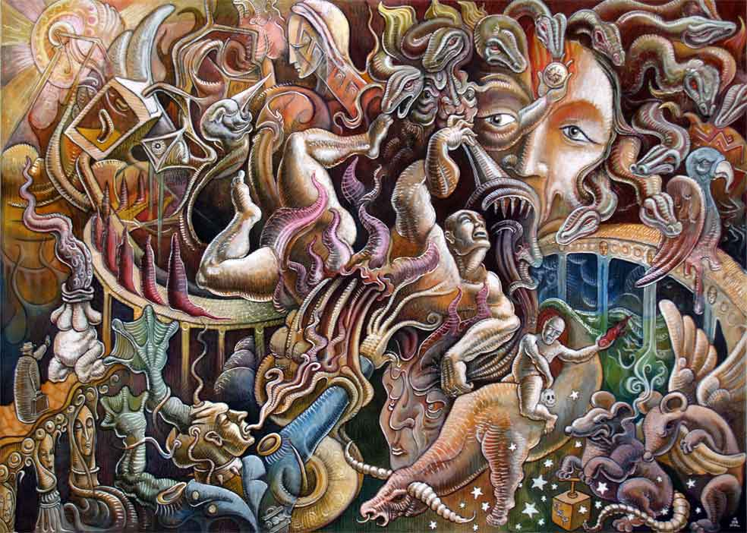
Tumult
n.: commotion; uproar; confusion.

Slide 16
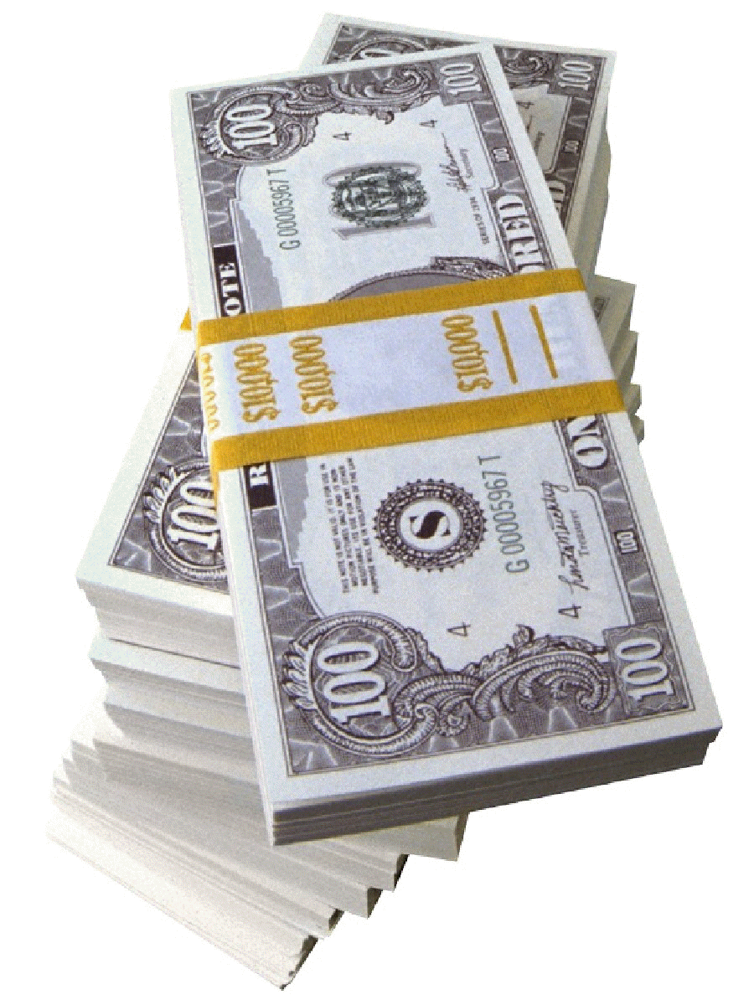
Restitution
n.: compensation; repayment.

Slide 17
Wednesday, September 21st
Convocation and early release

Slide 18
Thursday, September 22nd
Notes on epics
Notes on The Trojan War

Slide 19
Journal 8
Describe a trip that you have taken.

Slide 20
Proofreading Warm-up
Item 3
mrs jones doesnt say too Roger get you’re life in order
Corrected
Mrs. Jones doesn’t say to Roger, “Get your life in order.”

Slide 21
Proofreading Warm-up
Item 4
She is a kind person who’s example is a powerful lesson
Corrected
She is a kind person whose example is a powerful lesson.

Slide 22
Friday, September 23rd
Journal
DLP
Finish notes
View Trojan War documentary
Homework for the weekend: Get your journals in order to turn in next week.

Slide 23
Journal 9
Free Write Friday!

Slide 24
Proofreading Warm-up
Item 5
even if you have everything in life arranged the way youve planed there may be surprises.
Corrected
Even if you have everything in life arranged the way you’ve planned, there may be surprises.

Slide 25
Proofreading Warm-up
Item 6
We seen this theme, over and over again in the storys weve read so far this year.
Corrected
We have seen this theme over and over again in the stories we’ve read so far this year. (comma after theme deleted)

