Slide 1
Senior Boards Speeches
A short guide

Slide 2
Some Basic Issues
You do NOT need to stand behind a podium.
You are not required to use PowerPoint.
You are required to have some sort of visual.
Video clips should not exceed two minutes.
Face your audience
Figure out ahead of time how to click through slides

Slide 3
If you should decide to use PowerPoint
Bad Idea
Good Idea
Start by creating an outline The most important part of any presentation is the content, not the graphical appeal. That is why you should develop your presentation with the content first, before deciding on the look (colours, graphics, etc.) Create a good structure for your presentation by reflecting on the goal of the presentation, what your audience is thinking right now, and what points you need to make in order to move the audience from where they are to where you want them to be. Write an outline on paper or use sticky notes so you can move ideas around. By creating an outline first, you ensure that the content of your presentation is solid before you concern yourself with the visual elements. Use Contrasting Colours If you want your audience to be able to see what you have on the slide, there needs to be a lot of contrast between the text colour and the background colour. I suggest a dark background with light text – I usually use a medium to dark blue background and white or yellow letters. Some prefer a light background and dark letters, which will also work well - which you choose will depend on personal preference. Don’t think that just because the text looks fine on your computer screen that it will look fine when projected. Most projectors make colours duller than they appear on a screen, and you should check how your colours look when projected to make sure there is still enough contrast. To check that your colors have enough contrast, use the Color Contrast Calculator. Use a big enough font When deciding what font size to use in your presentation, make sure it is big enough so that the audience can read it. I usually find that any font size less than 24 point is too small to be reasonably read in most presentation situations. I would prefer to see most text at a 28 or 32 point size, with titles being 36 to 44 point size. The only reason I would use a font less than 24 point is when adding explanatory text to a graph or diagram, where you could use a 20 point font size. If you are given a small screen in a big room, your font will look smaller because the image will not be as big as it should be. In this case, see if you can get a larger screen, use a wall instead of a screen to project on, move the chairs closer to the screen or remove the last few rows of chairs. I've put together a chart that lists how far away the last row of your audience should be based on the size of screen, font size and visual acuity testing - use the Font Size chart here.
Avoid long sentences
Use a minimal number of text lines per slide
Use an easy-to-see font
Don’t overdo the special effects

Slide 4
Using visuals
Do it
Choose meaningful images
Should be eye-catching
Should add something to the presentation

Slide 5
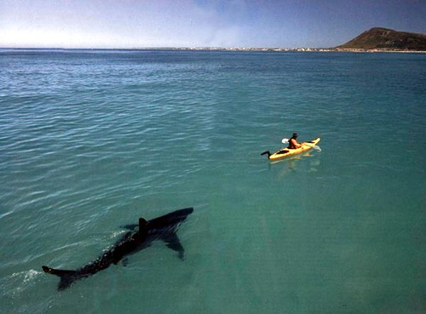
Using visuals
Don’t overdo it.

Slide 6
Pictures as Backgrounds
Bad idea
Good idea
If you do it like this, you can’t see it.
The audience struggles to read your text.
It just looks bad.
Give the text box a solid fill, then make it slightly transparent
Right click on text box
Click format shape
Select solid fill
Adjust transparency
Around 40% is good

Slide 7
Pictures as Backgrounds
Bad idea
Good idea
If you do it like this, you can’t see it.
The audience struggles to read your text.
It just looks bad.
Give the text box a solid fill, then make it slightly transparent
Right click on text box
Click “format shape”
Select “solid fill”
Adjust transparency
Around 40% is good

Slide 8
Another Option
You can make the whole picture transparent.
Right click on blank part of slide
Select “format background”
Check “picture or texture fill”
Where it says “Insert from,” click on file
Choose your file
Adjust transparency (toward the bottom of the menu)
Around 60% should be good, but play with it

Slide 9
Some Colors Do NOT Go Together
Bad Idea
Good Idea
Using colors that don’t contrast enough
Using colors that give people headaches (or seizures)
Using colors that contrast
Using a contrasting color that is pleasing to the eye

Slide 10
Choosing your words
Bad idea
Good idea
Put everything you plan to say on the slide because then you are tempted to read it to your audience, even though they are likely educated and can read for themselves.
This will also lead to putting too many lines of text on a slide.
Use short sentences of phrases
Leave yourself something to add
Why?

Slide 11
Structure of Presentation
According to the rubric

Slide 12
Introduction
Clear purpose established
Student introduced him/herself appropriately
Student caught listener’s attention quickly and appropriately
Hutch in the oven

Slide 13
Introduction Tips
No need for words to introduce yourself.
You already know your name, where you plan to go to college, where you live, etc.
Use an appropriate picture instead
Or just introduce yourself and your project while your title slide is up

Slide 14
Planning an Educational Trip to Belize
Ashley Hutchinson

Slide 15
Body
Main points supported with accurate detail
Logical organization
Topic adequately covered;
Student held listener’s attention
Physical
Why you chose it
Process
Learning stretch
Difficulties
Mentor
Research
How it connects to physical
Thesis
Couple of interesting facts

Slide 16
Introducing your Project
Say something attention-grabbing
There is no magic formula for this
Consider what you yourself found interesting about your project
Briefly mention the topic of your physical project AND your research paper

Slide 17
Educational Tour of Belize
2008 trip
Opportunity knocks!
Experiential education

Slide 18
Goals
At least 15 participants
Under $2500
At least three distinct landscapes
Biodiversity
Cultural diversity
See a spider monkey!

Slide 19
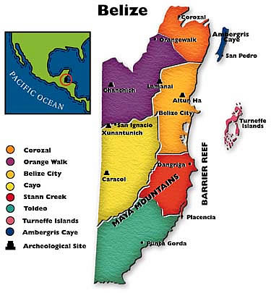
Getting Started
Logistics
Where?
When?
Communication
With tour company
With students
With parents

Slide 20
Evidence of Learning
Evidence of self-discovery
Use of “I learned” or “I discovered,” etc.
Evidence of significant learning stretch
Make sure to emphasize these things
Don’t make the judges guess
This can be done while describing whole process

Slide 21
Pre-trip Planning
Contact Explorica
Contact Teaching Fellows
Plan itinerary
Write proposal
Recruit students
Get students signed up
Make sure everyone pays

Slide 22
Belize Bound!
Get to know group
Tour Belize City
Poverty
People
Experience the rainforest environment
Jaguar preserve
Ziplining and cave tubing
Mayan ruins
Relax with the island life
Snorkeling

Slide 23
Balanced Content
Not too much on research paper or too much on project
Both elements adequately discussed
Student relates paper and project

Slide 24
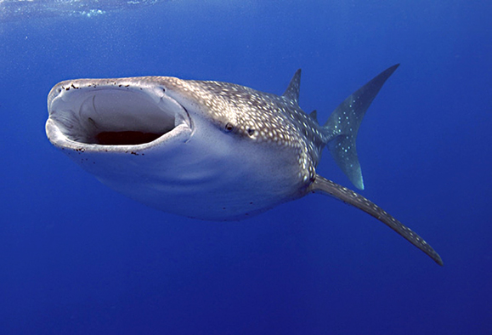
Belize Needs More Conservationists
Sea
Land

Slide 25
Conclusion
Student wraps-up effectively
Sense of closure; student leaves a
Memorable and positive impression
Student connects project to “real world”
This is a good place for your visual or demonstration
If you end on a video or demonstration, have something prepared to say at the end so the judges know it’s the end

Slide 26
Visual
student MUST include a visual aid or demonstration
Should be interesting
Appropriate
Able to be seen by audience
Neat
Creative
Helpful
On topic

Slide 27
Don’t Stop Belizein’

Slide 28
Language Usage
student uses standard English
precise word choice;
transitions are used to make connections
words are pronounced accurately
Student avoids distracting “fillers” (um, like, you know, uh, etc.)

Slide 29
Delivery
Section II ~ Delivery | potential points / value | scorer’s marks
A. EYE CONTACT: student looks at listeners; student does not read notes to audience; student distributes eye contact evenly | 8
B. NON-VERBAL SKILLS: student has appropriate posture, gestures and mannerisms; no distracting gestures; appropriate poise | 7
C. VERBAL SKILLS: appropriate volume; clear articulation; effective rate of speech and tone | 6
D. APPEARANCE / DRESS: appropriate and neat; professional attire; clothing can be specific to topic | 6
E. ENTHUSIASM / SINCERITY: student seems generally interested in his/her topic; shows enthusiasm about growth he/she experienced; is ready to share experience | 6

Slide 30
Look at the Audience
But don’t make it a creepy uncomfortable stare

Slide 31
Stand up Straight
Don’t rock the podium. In fact, just don’t use one.

Slide 32
Speak Clearly

Slide 33
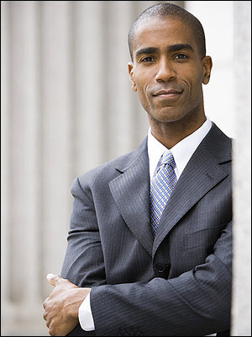
Dress Appropriately

Slide 34
Sound Like you Liked your Topic
I loved my project!
I learned so much!
Um, I, like, hated my project. It was, like, so boring. I wish I had done a different project. (Wah)

