Slide 1
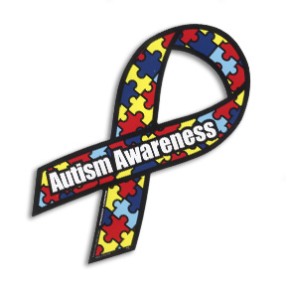
Treatments for Autism
By: Preston Bradsher, Phylicia Brown, Mingo Cue, Megan Daniel, and Meera Ravi

Slide 2
Treatments
Medicine
Behavior Therapy
Alternative Therapies

Slide 3
Medicinal Therapy
Trying to treat communication difficulties, social challenges and repetitive behavior
often combined with other treatments
most drugs are in clinical trials, it will be years before any are prescribed
not much is on the market, and the products that are don’t help every patient
Yielding different reactions, and some change over time
build tolerance or sensitization (side effects get worse)

Slide 4
Specific Medicines
Risperidone and Aripiprazole have been released to help curb the symptom of irritability, but it doesn’t treat it
often used to treat associated problems like ADHD, sleep trouble, depression- “off label”
naltrexone-can help stop repetitive or self-hurting behaviors (FDA approved for alcohol and opioid addiction)
selective serotonin re-uptake inhibitors (SSRIs), including Fluoxetine-depression and anxiety disorders

Slide 5
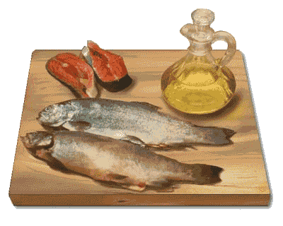
Diet
regulate digestion
through use of probiotics or digestive enzymes
increase omega 3’s
deficiencies are common-enzymatic defect
the fats are taken too quickly from the brain, causing autistic children to need more omega 3’s than others
after increase, improved behavior, mood,
imagination, impulsive speech, sleep
patterns and focus

Slide 6
Diet (ctn.)
increase vitamins and minerals
Dr. Bernard Rimland study proved vitamin B6, vitamin C and magnesium supplements improved symptoms in autistic children
other studies have been done, some yielding positive results, others negative, likely to improve on an individual basis
balance blood sugar
hyperactive kids eat more sugar than other children
unusually low tolerance for glucose in hyperactive children, may be what is causing the changing levels of concentration and focus

Slide 7
Diet (ctn.)
avoiding food allergies
unwanted foods and chemicals are reaching the brain through the bloodstream because of defective absorption and digestion
strongest evidence linking autism and wheat and dairy—because of the proteins gluten and casein that are in them
difficult to digest and if introduced to early in life can cause an allergy
fragments of these proteins can cause an increase in opioid activity, which can cause many symptoms that are identified with autism

Slide 8
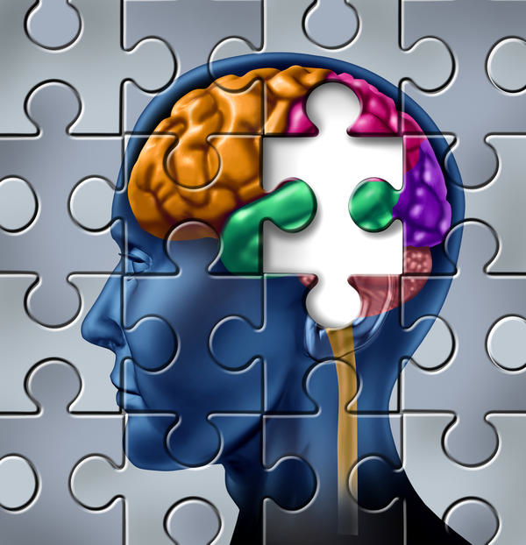
Behavioral Therapy
Types include
Cognitive behavioral therapy (CBT)
Applied Behavioral Analysis
Floor Time
Pivotal Response Treatment
Targets behaviors associated with autism

Slide 9
Cognitive Behavioral Therapy
Most beneficial for high-functioning teenagers and adults.
Intended to reduce anxiety and improve social skills
Usually lasts about 60 to 90 minutes for 6 to 16 weeks
Focuses on
Confronting negative thoughts using logical reasoning

Slide 10
Cognitive Behavior Therapy Cont.
Includes
Role playing
Exposure to dreaded situation
Demonstrate courageous behaviors

Slide 11
Applied Behavior Analysis
Include a wide range of techniques that utilize positive reinforcement
Intended to increase helpful behaviors and decrease actions that are harmful or slow the learning process
Can be used on a wide range of ages

Slide 12
Applied Behavioral Analysis Cont.
Promotes pleasant learning and positive social interactions
Specifically
Eye contact
Listening
Replication
Reading
Communicating
Understanding other’s point of view

Slide 13
Floor Time
Adults interact with kids at their level
Includes interactions during play
Intends to promote
Self instruction
Intimacy
Complex communication
Emotional thinking
Development of emotional thoughts

Slide 14
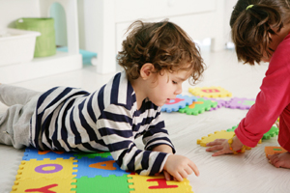
Floor Time Cont.
Encourages
Shared attention
Problem solving
Logical thinking
Effective in daily lives
Typical time duration is 2 to 5 hours per day

Slide 15
Pivotal Response Treatment
Derived from Applied Behavioral Analysis
One of the most studied and endorsed behavioral therapies
Typically a lifestyle adopted by the family
Most useful with younger kids
Endorses interactions initiated by the child

Slide 16
Pivotal Response Treatment Cont.
Targets important areas of development
Motivation
Self management
Self initiated interactions
Response to multiple stimuli
Goals
To Develop of language
To promote positive social behaviors
To reduce distraction due to self-stimulating actions
Usually implemented in 6 sections
Both prearranged and spontaneous

Slide 17
Example of Behavior Therapy
FITBI
Family-Implemented Treatment for Behavioral Inflexibility
Targeted repetitive behaviors found in autism
A therapist and parents of five children with autism used FITBI in clinic setting for 12 weeks
Noteworthy reductions in repetitive behavior found

Slide 18
Carly Fleischmann
16 year old living with autism
Used expensive and intense therapy, now is becoming more socially functional
Mentally advance despite physical disability

Slide 19
Judy Simpson
a former music therapist and is the director of government relations at the American Music Therapy Association
Has a 15 year old daughter Janna has autism along with a speech impairment and a seizure disorder
Judy uses music and singing as a way to get her daughter to engage in every day activities such as taking a bath, brushing her teeth, etc.
more friendly alternative to verbal instruction in helping her overcome social and behavioral problems

Slide 20
Alternative Therapies
Speech Therapy
Occupational Therapy
Physical Therapy

Slide 21
Problems with Speech and Communication
Speech Problems
Communication Problems
Screaming
Repeating words or phrases
Being nonverbal
Grunting
Humming
Babbling
Poor conversational skills
Trouble understanding word meaning
Lack of creative language
Inability to pick up on verbal and nonverbal social cues

Slide 22
Goals of Speech Therapy
Articulate words
Communicate verbally and nonverbally
Develop conversational skills
Comprehend verbal and nonverbal communication
Develop intricate sentences
Use appropriate sentences
Be able to express ideas
Form relationships through communication

Slide 23
Speech Therapy Techniques
Electronic “talkers”
Signing or typing
Using picture boards with words
Singing songs
To match rhythm of sentence flow
Exercising facial muscles
Improves articulation

Slide 24
Occupational Therapy
Program designed specifically for the patient according to his/her…
Interaction with environments
Attention span and stamina
Transitions between activities
Play skills
Need for personal space
Response to touch and other stimuli
Motor skills

Slide 25
Occupational Therapy Methods
Physical activities to teach coordination and body awareness
stringing beads, puzzles
Play activities for interaction and communication
Developmental activities
brush teeth, comb hair
Adaptive strategies
coping with transition

Slide 26
Goals of Occupational Therapy
Learn daily living skills
Develop fine motor skills
Develop gross motor skills
walking
riding a bike
Practice sitting still, posture, and perceptual skills
distinguishing between shape, size, and color
Learn body awareness
Practice visual skills
learning to look at the whole instead of the parts

Slide 27
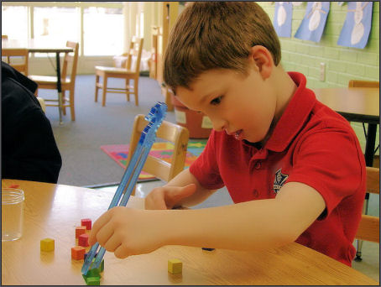
Benefits of Occupational Therapy
Through occupational therapy, a child may develop the skills to…
Develop relationships
Focus on tasks
Delay gratification
Play with peers
Self-regulate
Express feelings appropriately

Slide 28
Sensory Integration Therapy
A branch of occupational therapy
Helps with balance, body position, and space
Helps teach the child to combine the senses in his/her mind
Teaches the brain to process sensory information
Uses a combination of sights, sounds, feelings, smells, and possibly tastes simultaneously to let the child practice dealing with sensory input

Slide 29
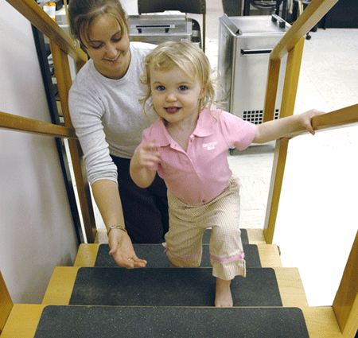
Physical Therapy
Teaches basic motor skills from a young age
Advances to more fine motor skills as the child gets older
Practicing body control and interaction with peers
Addresses misalignments in the muscular and skeletal system
Improves muscle tone
http://www.utica.edu/images/instadvance/marketingcomm/ptcrop.gif

